Slide 1
How DAC is generating LCI data for prospective LCA?

Slide 2
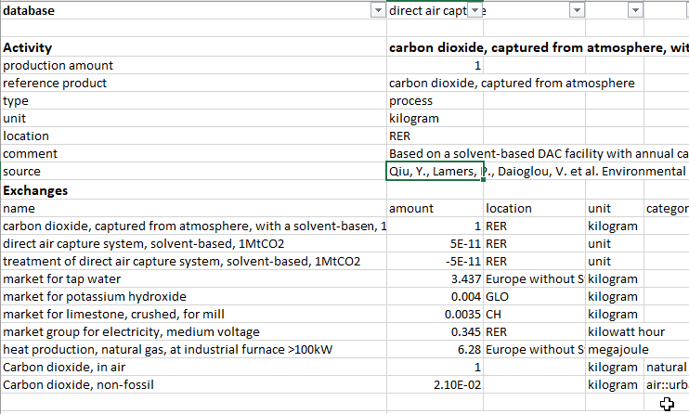
Parameters used in Premise DAC inventory
Energy:
Electricity consumption
Heat consumption
Not considered: Negligible inventories (less impacts) are not considered

Slide 3



Single life cycle inventory of DAC system
Life Cycle Inventory (LCI)
Direct Air Capture
System; LCA Model
CO2 …. g
CH4 …. g
0.4 kWh
1 kg
Electricity
CO2 captured
SO2 …. g
6 MJ
Energy (heat)

Slide 4

Single life cycle inventory of DAC system
Multiple, future Life Cycle Inventories (LCIs)
Direct Air Capture
System; LCA Model
CO2 …. g
CO2 …. g
CO2 …. g
CH4 …. g
CH4 …. g
0.4 kWh……………….. 0.3 kWh
CH4 …. g
1 kg
(2020)………………….(2050)
CO2 captured
SO2 …. g
SO2 …. g
SO2 …. g
Electricity
6 MJ……………………..5 MJ
(2020)………………….(2050)
Energy (heat)

